Slide 1
Bhupinder Singh Pratap Dangeti Dhanvanthri M
Hackathon: Sentiment analysis and stock performance

Slide 2
Problem Statement
How can we assess the financial stress in companies using company's financial results and stock market data?
Can we identify forward looking sentences from the Management Discussion and Analysis section of the annual reports ?
How are these parameters in the prediction models different across different industries/sectors for India market?

Slide 3
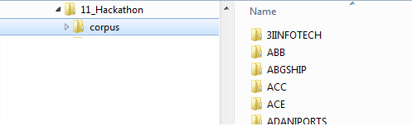
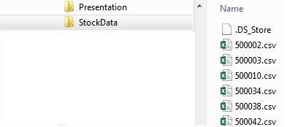
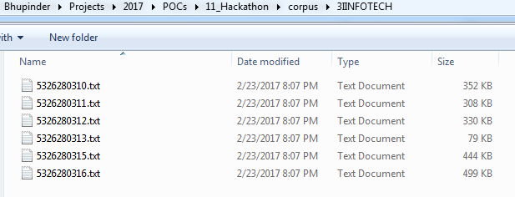
Data Sources
Annual Reports for companies – 186 companies (Mar 2010 – Mar 2016)
Corresponding stock market data for the companies – 147 files (Daily Stock Data Jan 2010-Dec 2015)
Annual Reports
Stock Data
5326280310.txt
520002.csv
Script ID
Annual Report Release Date: Mar 2010
Script ID

Slide 4







High-Level Solution Approach
Unstructured Annual Reports
Industry performance
Economic Outlook
Balance Sheet Ratios
Apache Tika
Pattern
Sentiment Analyzer
Attribute-wise Segmentation & Sentiment Analysis
Model Training & Validation
+
Stock Performance Reports
Machine Learning & Statistical Modeling
Aggregations on stock performance for 1 month, 6 month, 12 month durations
Stock Price Predictions

Slide 5


Selection of Tools
Python was our preferred choice for natural language processing (NLP), since R does not always scale well for NLP processing
Extraction of content from PDF was done using Apache Tika
We used Python NLTK for NLP in python (sentence tokenization)
We used CLIPS Pattern sentiment analyzer (lexicon based) – Gives polarity & subjectivity scores
Other sentiment analyzers: Affin, Sentiwordnet, Sentistrength, vadersentiment, sentiment package in R, etc.
Ref: SentiBench - a benchmark comparison of state-of-the-practice sentiment analysis methods, https://epjdatascience.springeropen.com/articles/10.1140/epjds/s13688-016-0085-1
We also tried extracting tables separately using pyTables (However, the results were poor)
We explored scikit-learn in python and regression & classification modeling in R to fit our classifiers on the dataset

Slide 6


Solution Approach: Detailed View
Annual Reports (PDF)
Annual Reports (TXT)
Structured Data
Preprocessing
Model Train & Validation
Sentiment Analysis
Filtering Texts by Category
Developed Ontology
3i_AR_Final AW 18-06-10_SAP_Print CTP.cdr
Five senses - one holistic entity.
A N N U A L R E P O R T
2009-2010
2009-2010
AA N N U A L R E P O R T
2009-2010
Company Details
Board of Directors:
Principal Bankers:
Used Pattern for sentiment analysis
Pol, Subj = sentiment(sentence)
Create Sentiment Classes from polarities:
Pos: +0.3 to 1
Neu: -0.3 to +0.3
Neg: -1 to -0.3
Create score for each category
Scores = (pos_count+1)/(neg_count+1)
Calculate Perc Stock Price change for 1 month, 6 month, 12 month durations
Merge with Stock Data
Sentiment scores range from 0 – 35
Decide cut points for senti scores
0, 5, 10, 15, 20, 25
Target variables range
Range: 4.08 to 7.7
Decide cut points for target
0, 4.9, 5.1, 5.3, 8
library("nnet")
m2 <- multinom(binned_y_target12 ~ .,data = train_data)
summary(m2)
library(ROCR)
pred = predict(m2,test_data)
table(pred, test_data$binned_y_target12)
Sentence Tokenization
Filtering sentences Category = Margin

Slide 7
Solution Approach: Analysis of Annual Reports
Annual Reports (TXT)
Create Category Scores
Preprocessing
Sentence Tokenization
Sentiment Analysis
Get Sentiment Classes
Filtering Sentences by Category
Annual Reports (PDF)
3i_AR_Final AW 18-06-10_SAP_Print CTP.cdr
Five senses - one holistic entity.
A N N U A L R E P O R T
2009-2010
2009-2010
AA N N U A L R E P O R T
2009-2010
Company Details
Board of Directors:
Principal Bankers:
Thresholds:
Neg: -1 to -0.3
Neu: -0.3 to 0.3
Pos: +0.3 to 1
Create score for each category
Scores = (pos_count+1)/(neg_count+1)
neutral | 60
positive | 2
Score = 3/1
All Sentences
Filtered Sentences

Slide 8
Solution Approach: Analyzing Stock Data
Stock Data
Binning
Calculate Change in Stock Price
Transforming Stock Price Change
Calculate for 1, 6 and 12 months
Date, Closing Price
Change in Closing Price
Create score for each category
Y target
= ln(stock price change + 150)
Target variables range
Range: 4.08 to 7.7
Decide cut points
0, 4.9, 5.1, 5.3, 8
ID: 500002
Y_target1 = 5.009
Y_target6 = 4.926
Y_target12 = 4.868

Slide 9
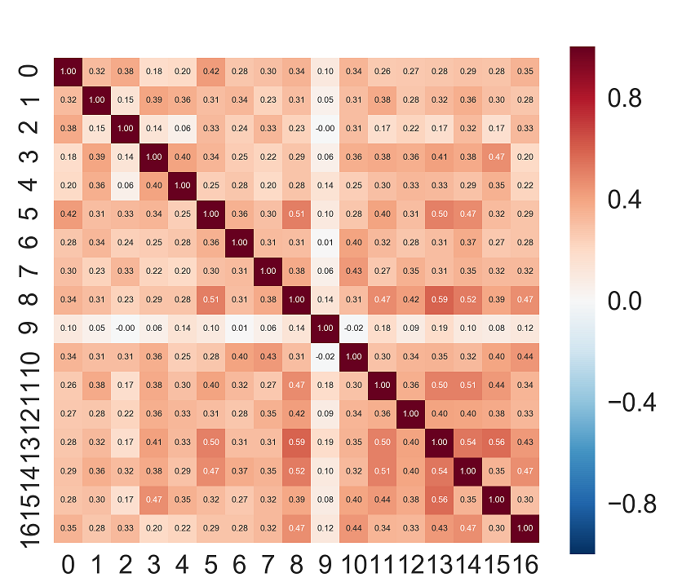
Exploratory Data Analysis
Mergers & acquisitions & recent trends
Variables 13, 8 - Corr Coeff 0.59
Recent trends & Revenue
Variables 13, 15 – Corr Coeff 0.56

Slide 10
Exploratory Data Analysis
Target variables corresponding to Stock Price change for 1 month, 6 month, 12 month durations
Y_target = ln(% Stock Price Change + 150)
Y_target12
Negative: 237
Positive: 361
Y_target12
Model Data:
598 rows for 113 unique companies
Binned_senti_score_revenue

Slide 11
Exploratory Data Analysis

Slide 12
Exploratory Data Analysis

Slide 13
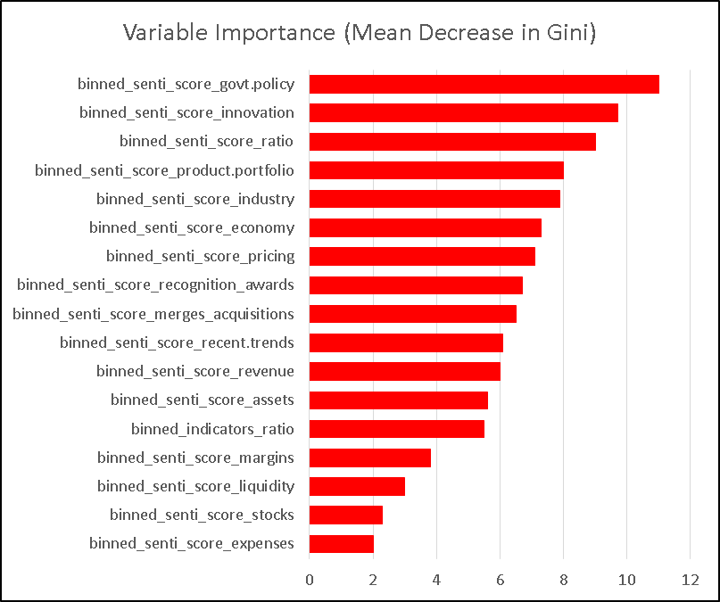
Model Training & Validation – Random Forest
Data preprocessing: 598 rows for 113 unique companies after removing observations with NA values, we have 510 rows. Split has been performed by 70% (357 observations) - 30% (153 observations) as Training & Testing data respectively
Model Building:
Random forest is applied using Grid Search to tune parameters of No. of columns selected, Maximum nodes, Number of trees
For each parameters combination, probability cut-off selected based on sensitivity-specificity chart to create confusion matrix
Finally classified predicted probabilities of test data based on cut-off generated by sensitivity-specificity plot
Computed Confusion matrix and calculated Accuracy, precision, recall & f1-scores on test data
Grid Search:
During grid search we have explored on following hyper parameters
No.of columns selected – [2,3,4,5,6,7,8,9]
Max nodes – [8,16,32,64,128]
Number of Trees – [1000,1500,2000,5000,10000]
Best parameter combination from Grid Search:
Best parameter after performing entire space, best pairs are, No.of columns – 8, Max nodes – 64, Number of trees – 1000 with test accuracy as 61.43%

Slide 14
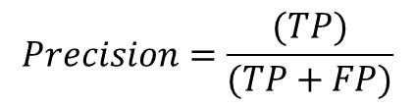
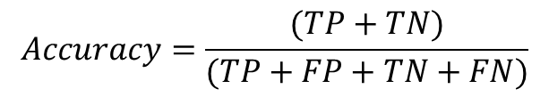
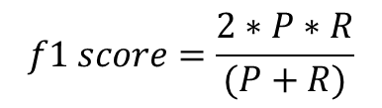
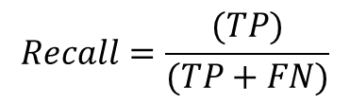
Model Training & Validation – Random Forest
Results: Accuracy, Precision & Recall are calculated to measure the performance on test data with 153 observations
Predicted
Stock Price Change
 | Negative (0,5.01] | Positive (5.01,8]
Negative (0,5.01] | 50 | 21
Positive (5.01,8] | 38 | 44
Actual Stock Price
Change
$$Accuracy=\frac{(TP+TN)}{(TP+FP+TN+FN)}$$
 | Precision | Recall | f1
Negative (0,5.01] | 56.8 % | 70.4% | 62.87%
Positive (5.01,8] | 67.6% | 53.65% | 59.85%
Overall | 63.4% | 61.2% | 61.3%
$$Precision=\frac{(TP)}{(TP+FP)}$$
$$Recall=\frac{(TP)}{(TP+FN)}$$
$$f1 score=\frac{2∗P∗R}{(P+R)}$$

Slide 15
Results – Results for % stock price change for 12 month duration (Y_target12)
Model | Description - binning | Accuracy | Prec | Recall | f1
Nnet (multinomial) | cuts1 = 5 # bins with equal ranges | 0.702 | 0.56 | 0.67 | 0.59
Random Forest | cuts1 = 5 # bins with equal ranges | 0.755 | 0.51 | 0.71 | 0.59
Nnet (multinomial) | Manually selected cuts2 = c(0,5.0,5.2,5.4,8) | 0.3377 | 0.31 | 0.39 | 0.34
Random Forest | Manually selected cuts2 = c(0,5.0,5.2,5.4,8) | 0.4238 | 0.33 | 0.47 | 0.34
Nnet (multinomial) | cuts3 = c(0,5.2,5.4,8) | 0.6887 | 0.52 | 0.67 | 0.59
Random Forest | cuts3 = c(0,5.2,5.4,8) | 0.7152 | 0.52 | 0.72 | 0.60
Nnet (multinomial) | cuts4 = c(0,log(150-10),log(150),5.4,8) | 0.2781 | 0.32 | 0.38 | 0.32
Random Forest | cuts4 = c(0,log(150-10),log(150),5.4,8) | 0.4371 | 0.36 | 0.43 | 0.35
Nnet (multinomial) | cuts5 = c(0,log(150-25),log(150-10), log(150),5.4,8) | 0.298 | 0.23 | 0.35 | 0.25
Random Forest | cuts5 = c(0,log(150-25),log(150-10), log(150),5.4,8) | 0.298 | 0.21 | 0.39 | 0.24
Nnet (multinomial) | cuts6 = c(0,log(150),8) | 0.4901 | 0.29 | 0.54 | 0.37
Random Forest | cuts6 = c(0,log(150),8) | 0.6087 (at conf threshold 0.71) | 63.4% | 61.2% | 61.3%
SVM | cuts6 = c(0,log(150),8) | 0.58

Slide 16
Insights
A classifier was built to predict stock price change (negative, positive) using Random Forest (~61% F1)
Additional variables such as actual profits, revenues, etc. may improve the performance of the model
These may be parsed from the structured data tables or extracted from unstructured text by leveraging the high frequency grammatical patterns in text
Inclusion of industry type, as a variable could enhance the performance of the model

Slide 17
Thank You

Slide 18
References
Ref: SentiBench - a benchmark comparison of state-of-the-practice sentiment analysis methods, https://epjdatascience.springeropen.com/articles/10.1140/epjds/s13688-016-0085-1
Sentiment Analysis using pattern
http://www.clips.ua.ac.be/pattern
Important financial ratios
https://en.wikipedia.org/wiki/Financial_ratio
PDF to text convertion using Apache Tika
https://tika.apache.org/

Slide 19
Software Installation and Steps of Execution
Pip install pandas
Pip install pattern
Pip install tika
Open and execute extract_pdf.py
Open sentiment_analysis.py and modify the following lines:
inFile = input.csv'
outFile = 'result.csv'
corpus_folder = ‘corpus‘ #folder location where the extracted txt files for annual reports are located
attr_filters = ['growth', 'revenue', 'profit'] #update the list for filtering relevant sentences from the unstructured data
Running the code
Python sentiment_analysis.py
Run R codes for model training and execution
Run data_prep.R for preprocessing
Run Hack_Model_v6.R for model training and validation

Slide 20
Solution Approach
Unstructured data was extracted using apache tika
We segmented the documents into sentences
We filtered the sentences by relevant keywords
We ran the sentiment analyzer to extract sentiments for each sentence
We created an aggregation score to get an overall sentiment for the relevant section of the sentiment
We aggregated the stock market data by 1 month, 6 months & 12 months
We merged this sentiment scores with the aggregated stock market data and fit machine learning classifiers on it
The raw sentiment scores were binned at the following cut points (0,5,10,15,20)
The aggregated stock market data for 1, 6 and 12 months were also transformed ln(%price change + 150) and then binned into 5 equal partitions – 150 was added in order to be able to perform ln transformation for negative stock price changes as well

